Slide 1
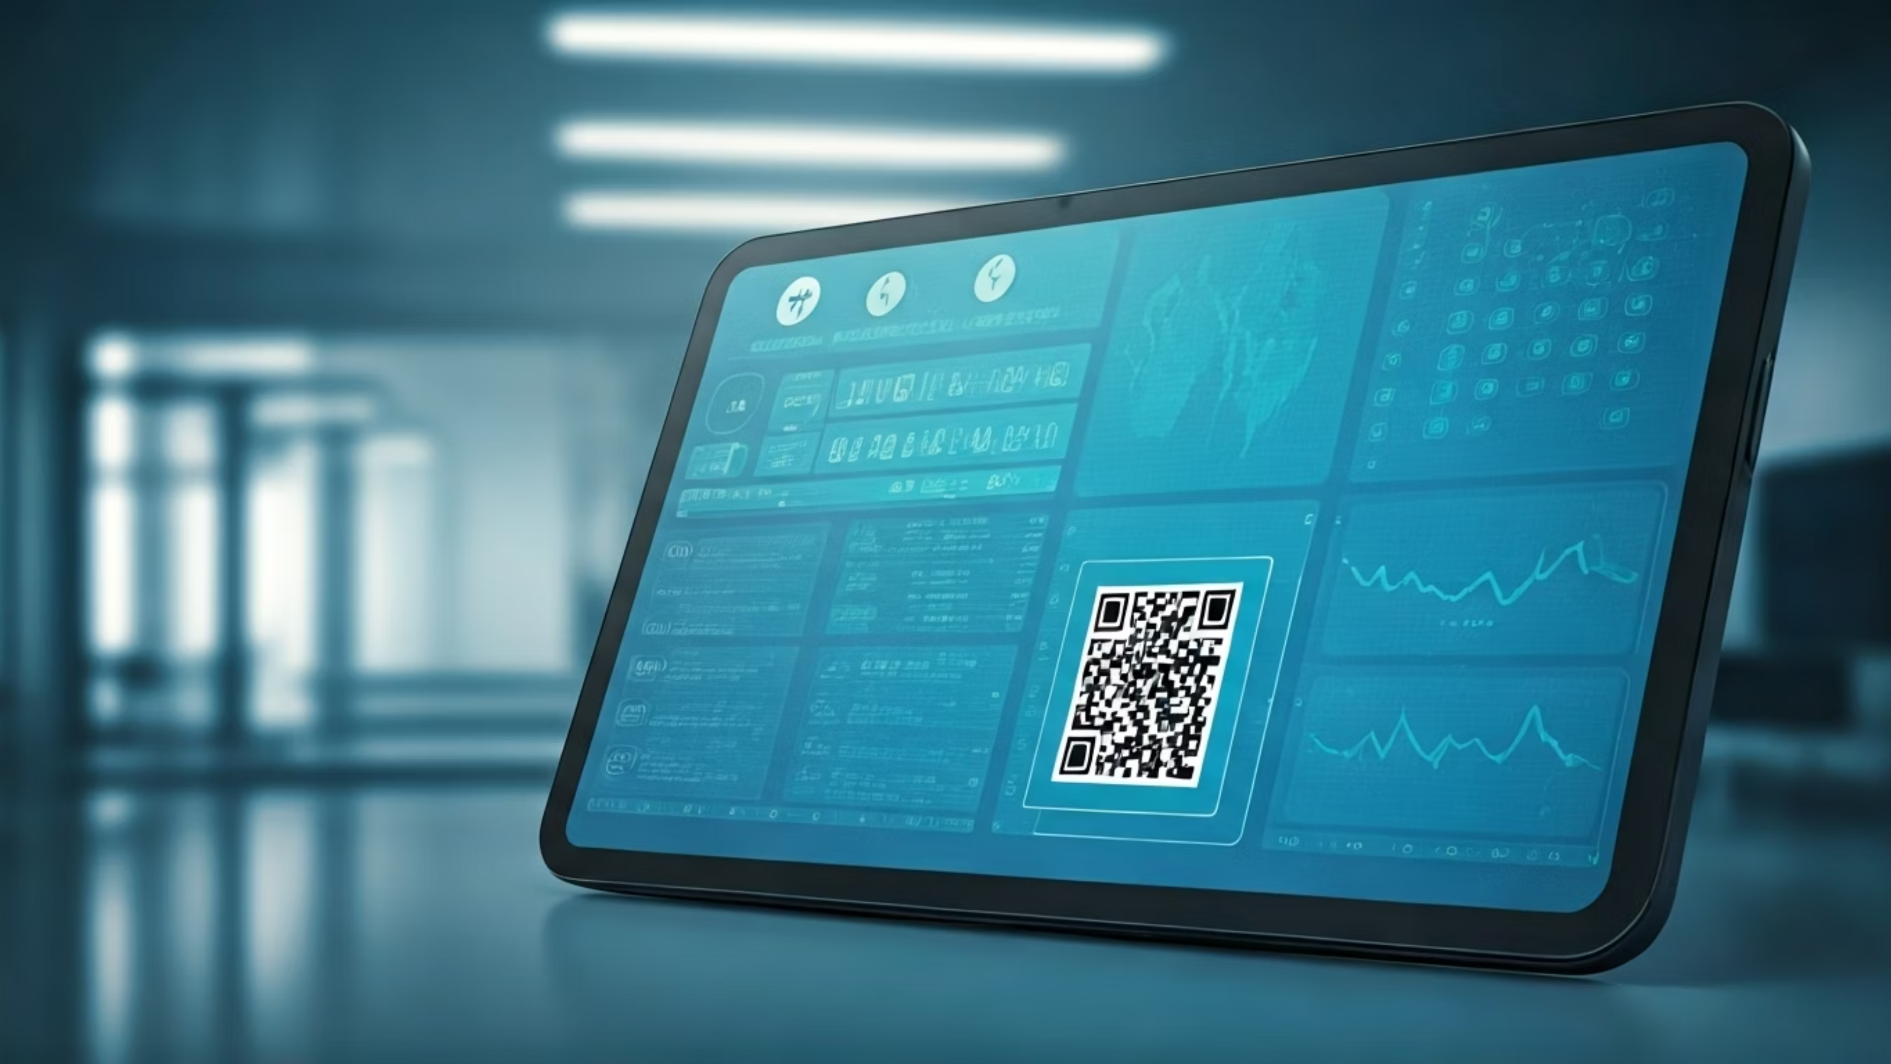
Mediband – Revolutionizing Hospital Experiences
Mediband is poised to transform the healthcare landscape by streamlining patient experiences. We tackle the prevalent issues of long wait times, tedious paperwork, and fragmented medical information. Our innovative platform enables instant access to vital patient data, ensuring that every hospital visit is efficient, accurate, and stress-free. This document outlines Mediband's core features, market impact, and strategic vision for a more connected and patient-centric healthcare future.

Slide 2



The Current Healthcare Hurdle: Time, Errors, and Frustration
Imagine walking into a hospital only to be met with a daunting stack of paperwork, forcing you to repeatedly fill out the same information you’ve provided countless times before. This isn't just an inconvenience; it's a fundamental flaw in the patient journey. Every hospital visit today is burdened by inefficient processes that lead to frustration for patients and staff alike.
Wasted Time
Long queues and repetitive data entry
Patients endure long lines and tedious forms, wasting precious time and effort that could be spent on actual care. For healthcare providers, the reliance on paper records is a constant source of errors, lost information, and critical delays. This outdated system often prevents doctors and nurses from accessing immediate, accurate medical histories, which directly impacts the speed and quality of care.
Prone to Errors
Manual processes lead to inaccuracies and loss
Lack of Access
Slow, fragmented medical history retrieval
"Patients deserve a seamless, fast, and accurate way to manage their health information. The current system fails them."

Slide 3
Mediband: Your Seamless Digital Healthcare Companion
Mediband is the transformative solution that bridges the gap between patient needs and hospital efficiency. At its core, Mediband is a sophisticated web application designed to revolutionize the patient intake process. Upon registration, patients securely store their essential medical data within our platform. When visiting a hospital, Mediband intelligently pre-fills all necessary forms, eliminating the need for repetitive, time-consuming manual entry.
Each patient receives a unique, scannable QR code, serving as their digital key to instant verification and rapid access to their pre-filled forms. Furthermore, patients can easily download a PDF of their completed forms and prescriptions, facilitating effortless sharing with doctors, specialists, or pharmacies. This immediate access to accurate, portable information vastly improves communication and care coordination.
Looking ahead, Mediband envisions a future with integrated NFC (Near Field Communication) technology. This advancement will allow patients to carry all their critical health information—including medical history, active prescriptions, and medication lists—on a tiny, secure wearable device or card. This futuristic yet tangible application promises instant, secure, and truly portable access to personal health data, making medical information as accessible as a tap.
"Mediband transforms hospital visits from stressful to effortless, saving time for patients and staff alike, redefining healthcare interactions for the digital age."

Slide 4
Key Features & Breakthrough Innovation
Auto-Prefilled Forms
1
Effortless Data Entry: Patients input their information once, and Mediband automatically populates all required hospital forms for subsequent visits, drastically reducing paperwork and wait times.
2
Scannable QR Codes
Instant Verification: A unique QR code provides quick, secure access to a patient's pre-filled forms, enabling rapid check-ins and efficient data retrieval by staff.
Downloadable PDFs
3
Seamless Sharing: Patients can download and share their completed forms and prescriptions as PDFs, ensuring easy communication with healthcare providers and pharmacies.
4
NFC Integration (Future)
Health Info at Your Fingertips: Upcoming NFC capability allows patients to carry all vital health data on a secure wearable or card, offering instant, portable access.
5
Patient-Centric Design
Simple, Secure Workflow: Our intuitive design prioritizes ease of use, ensuring a smooth, secure, and error-free experience for patients and staff.
"We are not just digitizing forms; we are redefining patient experience in healthcare by focusing on speed, accuracy, and empowerment."

Slide 5

Market Potential and Transformative Impact
The healthcare market represents an immense opportunity for Mediband. Annually, hospitals process millions of patient visits, each accompanied by a mountain of paperwork. This translates into hundreds of millions of wasted hours and significant operational inefficiencies across the global healthcare system. Mediband directly addresses this inefficiency.
By eliminating redundant data entry and streamlining patient intake, Mediband can dramatically reduce waiting times, sometimes by as much as 50-70% during peak hours. This directly translates into improved patient throughput and higher satisfaction scores for hospitals. Furthermore, by digitizing and standardizing patient information, Mediband significantly improves record accuracy, minimizing medical errors and reducing legal risks for healthcare providers.
Beyond operational benefits, Mediband empowers patients, giving them greater control and accessibility to their own health data. The platform is inherently scalable, designed to be seamlessly integrated across individual clinics, large hospital networks, and eventually, national healthcare systems, promising a widespread positive impact on public health infrastructure.
Mediband's Impact on Hospital Efficiency
Millions of patient visits annually
Significant reduction in paperwork-related wait times
Empowers patients with data control
Scalable across all healthcare institutions
"Mediband is not just convenience—it’s efficiency, accuracy, and better healthcare delivery on a global scale."

Slide 6
Why Hospitals Will Pay for Mediband
Hospitals are constantly seeking ways to improve operational efficiency, reduce costs, and enhance patient satisfaction. Mediband offers compelling, quantifiable benefits that directly address these core objectives, making it an indispensable investment for any healthcare institution.
01
02
03
Reduced Patient Waiting Time
Minimized Errors and Legal Risks
Significant Cost Savings
By pre-filling forms and enabling QR-code access, Mediband drastically cuts down on administrative bottlenecks. This means hospitals can process patients faster, reduce congestion in waiting areas, and ultimately, see more patients per day, optimizing their capacity and increasing revenue.
Manual data entry is a significant source of errors in patient records and prescriptions, leading to potential medical mistakes and legal liabilities. Mediband ensures accurate, consistent digital data, leading to better patient outcomes and a substantial reduction in the risk of complaints or litigation.
Hospital staff spend countless hours on manual form management, scanning, and filing. Mediband automates this entire workflow, leading to substantial savings on administrative overhead, staffing costs, and physical paperwork.
04
05
Enhanced Patient Experience
Competitive Advantage
Patients value convenience and efficiency. By offering a streamlined experience, hospitals adopting Mediband will see higher patient satisfaction scores, which are critical for reputation, ratings, and attracting new patients in a competitive healthcare landscape.
In an increasingly digital world, hospitals that embrace innovative solutions like Mediband position themselves as tech-savvy and patient-friendly leaders. This provides a distinct competitive edge, attracting more patients and improving brand value.
In essence, hospitals will invest in Mediband because it delivers a clear Return on Investment (ROI) by saving time, reducing errors, cutting costs, and elevating their standing in the eyes of their patients.

Slide 7
Diverse and Sustainable Revenue Models
Mediband's strategic revenue model is designed for sustainability and scalability, integrating multiple streams to serve various stakeholders within the healthcare ecosystem. Our approach blends recurring subscriptions with value-added services, ensuring robust growth potential.
B2B Subscription Model (Hospitals & Clinics)
Per-Patient / Pay-Per-Use Model
How it works: Hospitals and clinics pay a monthly or yearly subscription fee for integrating Mediband into their existing patient intake systems.
Flexibility: Hospitals or clinics pay a fixed fee for each patient registration processed through Mediband.
Pricing: Tiered plans based on organizational size and patient volume.
Example: $1–$5 per patient form processed.
Small clinic: $500–$1,000/month
Best for: Smaller practices or those hesitant to commit to a large subscription, offering a low-barrier entry point.
Medium hospital: $2,000–$5,000/month
Large hospital: $10,000–$20,000+/month
Premium Patient Services
Benefits: Predictable recurring revenue, aligned with client's operational scale.
Optional Upgrade: Patients can opt for NFC-enabled wearables or cards containing their comprehensive health data.
SaaS for Pharmacies / Doctors
Expansion: Extend Mediband's reach to pharmacies and individual practitioners, offering secure, quick access to patient prescriptions and relevant health history.
Revenue: One-time device cost (e.g., $50–$100) plus an optional monthly subscription for cloud storage and enhanced data management ($5–$10/month).
Revenue: Subscription fees or a per-access charge for verified data retrieval.
Data Insights & Analytics (Future, Privacy-Compliant)
Value-Add: Offer anonymized, aggregated insights on patient flow, common conditions, or medication trends to hospitals and health providers.
Compliance: Strict adherence to HIPAA, GDPR, and other relevant privacy laws is paramount.
"Our revenue model combines recurring subscriptions for hospitals, optional premium devices for patients, and value-added services for doctors and pharmacies, creating a sustainable and scalable business foundation."

Slide 8



Phased Product Roadmap: A Vision for Connected Healthcare
Mediband's development will unfold in strategic phases, ensuring robust delivery of core features while continuously innovating towards a fully integrated digital healthcare ecosystem. Our roadmap is designed to maximize immediate impact while building towards a comprehensive, future-ready platform.
Phase 1: Web App & QR Codes
Phase 2: NFC Integration
Phase 3: Expanded Ecosystem & Insights
The foundational phase focuses on launching the core Mediband web application. This includes secure patient data storage, automated form pre-filling capabilities, and the generation of unique, scannable QR codes for rapid patient identification and access. Downloadable PDF forms and prescriptions will also be a key feature, enabling seamless digital sharing. This phase addresses the most pressing pain points of manual paperwork and long wait times.
Building on the web app's success, Phase 2 introduces advanced NFC (Near Field Communication) technology. This will allow patients to securely store their complete medical history, active prescriptions, and critical medication lists on a compact, NFC-enabled wearable or card. This innovation provides instant, tap-and-go access to vital health information, even without an internet connection, significantly enhancing portability and convenience for users and emergency responders.
The final phase extends Mediband's reach into a broader healthcare ecosystem. This involves integrating with pharmacies for direct prescription fulfillment, connecting with insurance providers for streamlined claims, and exploring secure, anonymized data insights for healthcare providers to optimize patient flow and identify key health trends. This comprehensive integration aims to create a truly interconnected and intelligent healthcare experience.
Our phased approach ensures rapid deployment of immediate solutions while laying the groundwork for a future where healthcare is truly at your fingertips, anytime, anywhere.

Slide 9
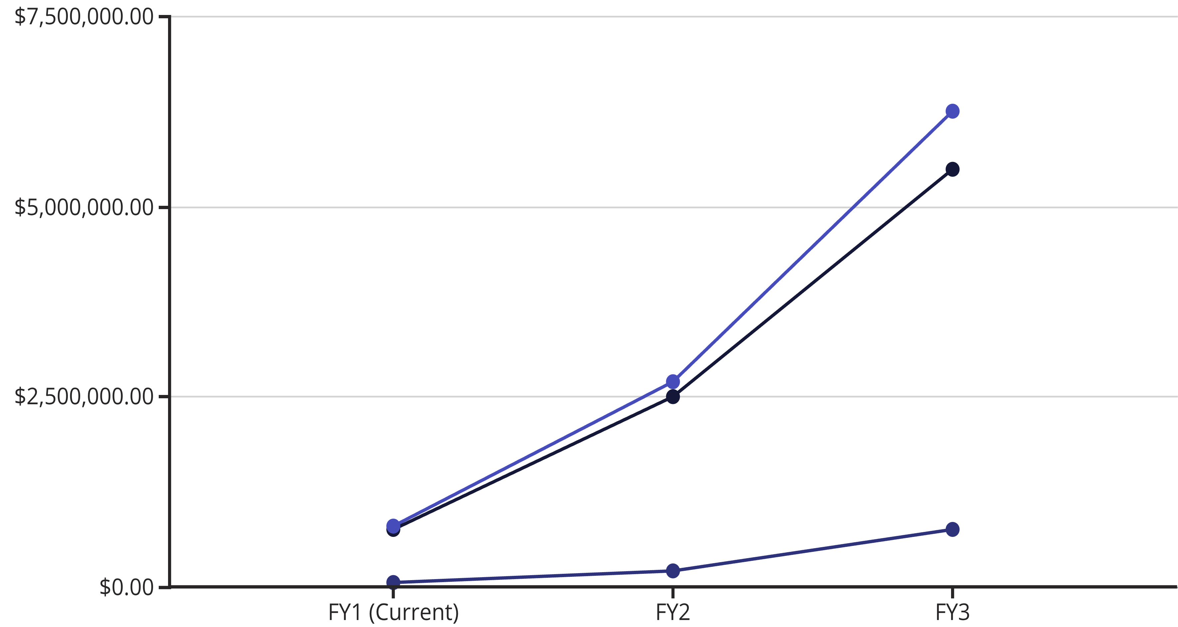
Illustrative Financial Projections: 3-Year Growth
Our financial projections demonstrate a robust and accelerating growth trajectory over the next three years, driven by the strong market demand for digital healthcare solutions and our diversified revenue streams. These estimates are based on conservative adoption rates and increasing average revenue per hospital as we expand our feature set and integrate new services.
Subscription Revenue
Premium Services
Total Revenue
Key Growth Drivers:
Year 1: Focus on initial hospital subscriptions and securing key pilot programs, establishing market presence and proof of concept.
Year 2: Significant expansion through aggressive sales to medium and large hospitals, complemented by the introduction of premium patient NFC devices.
Year 3: Accelerated growth from full-scale adoption across hospital networks, scaling premium services, and potentially early monetization of pharmacy/doctor SaaS and anonymized data insights.
These projections highlight Mediband's potential to become a leading force in digital healthcare, generating substantial returns for investors while delivering immense value to patients and providers alike.

Slide 10
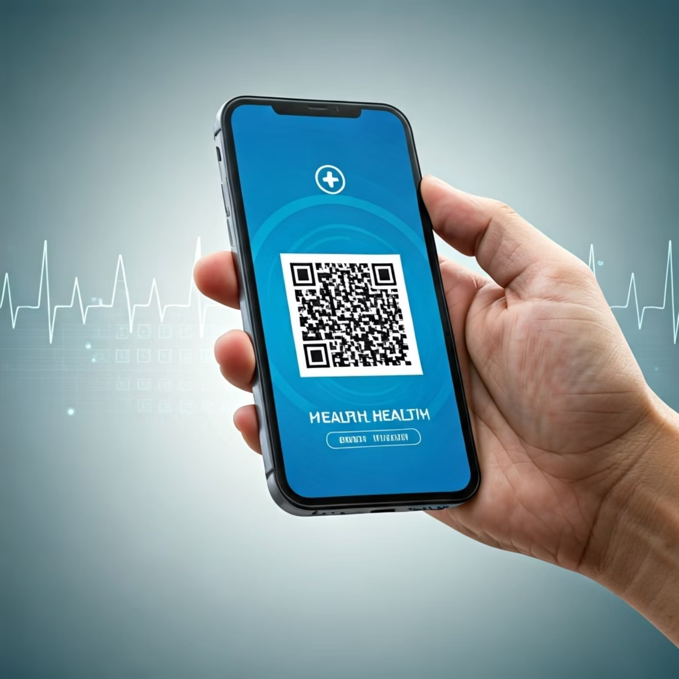


Join Us: Bringing Healthcare into the Digital Age
Your medical history travels with you—secure, accessible, and ready when you need it.
Mediband is more than just an application; it's a paradigm shift in how we experience healthcare. We are building a future where administrative burdens are replaced with seamless efficiency, where critical information is instantly available, and where patients feel empowered and prioritized.
The journey to transform healthcare is ambitious, but with Mediband, we are making it a tangible reality, one QR code, one seamless interaction at a time. We invite hospital administrators, healthcare IT decision-makers, and investors in digital health to partner with us.
"Let's bring healthcare into the digital age, making it fast, accurate, and accessible for everyone. Connect with Mediband today to schedule a live demonstration and explore partnership opportunities."

